Slide 1


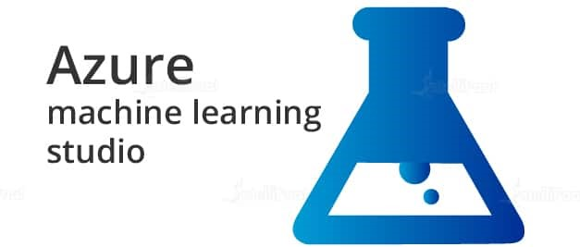
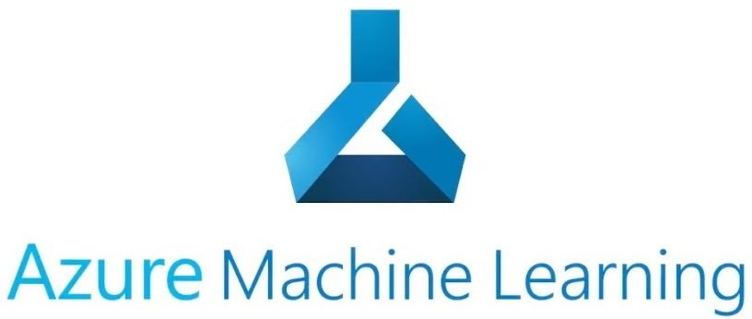
AZURE ml

Slide 2
AZURE ML
Azure Machine Learning Service: is a fully managed cloud service that is used to train, deploy, and manage azure machine learning models.
Machine learning professionals can use it in their day-to-day workflows: Train and deploy models, and manage MLOps.
You can create a model in Azure Machine Learning or use a model built from an open-source platform, such as Pytorch, TensorFlow, or sci-kit-learn. MLOps tools help you monitor, retrain, and redeploy models.
Azure Machine Learning Service is an enterprise-level service for building and deploying machine learning models. It allows us to create, test, manage, deploy, or monitor ML models in a scalable cloud-based environment. It supports numerous open-source packages available in Python such as TensorFlow, Matplotlib, and sci-kit-learn.
Main feature: It has the potential to auto-train and auto-tune a model.
The model can be trained on a local machine and then deployed on the cloud.

Slide 3
AZURE ML
Azure ML Studio: is a workspace where you create, build, train the machine learning models.
It is the web portal for data scientist developers in Azure machine learning. The studio combines no-code and code-first experiences for an inclusive data science platform.
Features Of Azure Machine Learning Studio:
It is fully integrated with Python and R SDKs.
It has an updated drag and drop interface generally known as Azure Machine Learning Designer(preview).
It supports Pipelines where we can build flexible and modular pipelines to automate workflows.
It supports multiple model formats depending upon the job type.
It has Automated model training and hyperparameter tuning with code first and no-code options.
It supports data labelling projects.

Slide 4
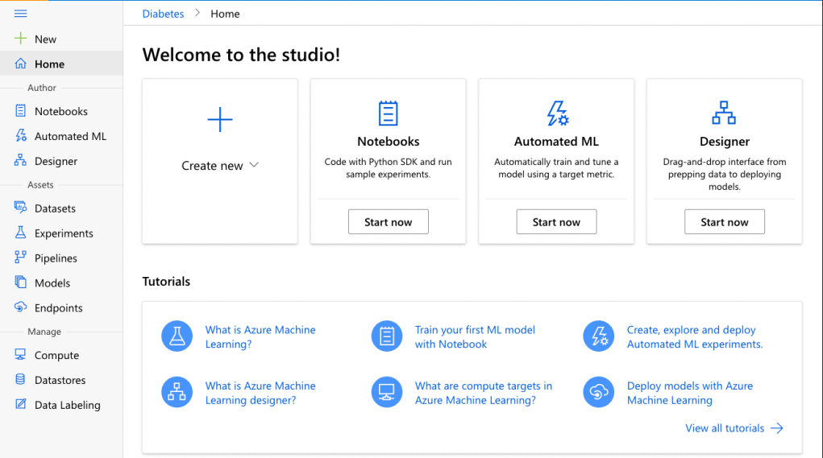
AZURE ML
Architectural View Of Azure ML Studio:
The Azure ML studio provides a view of all the artifacts in the workspace.
We can get a detailed view of the details and results of our experiments, pipelines, datasets, model, etc.
Azure Machine Learning studio is a web portal in Azure Machine Learning that contains low-code and no-code options for project authoring and asset management.
Azure Machine Learning helps data scientists and ML engineers rapidly build and deploy machine learning regardless of skill level.

Slide 5
AZURE ML
Studio has the following Components:
1. Notebooks– It is used to write and run code in integrated Jupiter notebooks. It is useful for any workspace and supports multiple languages including Python, R, etc.
It requires no installation and is a free service.
2. Automated ML– It is used for training and tuning the model. In other words, it is a process of automating the iterative, time-consuming tasks of machine learning model development.
It helps the developers in building ML models with high efficiency, scale, and productivity all the while sustaining model quality and also saves time and resources.
3. Designer– It is an interactive interface to connect datasets and modules to create machine learning models.
It is a drag and drop tool where you can drop the datasets and modules and connect the modules to create a pipeline (Pipeline consists of datasets and modules which are connected).

Slide 6
AZURE ML
4. Datasets– Used for easy access to data for the model. They create a reference to the data source location and create a copy of its metadata.
Datasets can be created from datastores, Azure Open Datasets, or public URLs.
They are of two types: File Datasets and Tabular Datasets and both can be used in Azure Machine Learning Training workflows.
5. Experiments– It is used for grouping runs for a specified script. It represents the main entry point for creating and working with the experiments in azure.
It always belongs to a workspace and if an experiment is not found in the namespace then a new Experiment is created.
Information for a run is stored in the experiment for which a name is provided before submitting the run.
The name must be 3-36 characters and must start with a letter or a number.

Slide 7
AZURE ML
Models– It is a piece of code that takes input and produces the output for the given inputs.
Creating a model in machine learning involves selecting an algorithm, providing it with data, and tuning the hyperparameters (Hyperparameters are adjustable parameters that are selected to train a model that govern the training process itself).
While creating a model any popular machine learning framework can be used such as PyTorch, TensorFlow, Scikit-learn, etc. A model can be trained outside the Azure Machine Learning or in the Azure Machine Learning.
7. Endpoints– It provides remote access to the services that are running.
It is an instantiation of the created model into either an IoT module for integrated device deployments or web services that can be hosted in the cloud.

Slide 8
AZURE ML
8. Compute- A Compute/Compute Target is a machine or a set of machines that are used to run the training scripts or host service deployments. A local machine or a remote compute resource can be used as a compute target.
With the help of computing targets, the training can be started on local machines and then scaled out to the cloud without changing the training script.
9. Datastores- Datasets use datastores for secure connection to the Azure storage services. They store connection information without putting the integrity of the original data source and authentication credentials at risk.
10. Data Labeling- It provides a central place to create, manage, and monitor labelling projects and tracks progress and maintains a queue of incomplete labelling tasks.
The labelled data can be viewed and exported as an Azure Machine Learning dataset.

Slide 9
AZURE ML
Azure Machine Learning Designer:
It is a drag and drop tool (Azure Machine Learning Designer) where you can drag the data sets and further process the analysis on that data.
It offers both no-code and low-code options for projects.
we can drop datasets and modules for creating ML pipelines.
drag-and-drop interface used to train and deploy models in Azure Machine Learning.

Slide 10
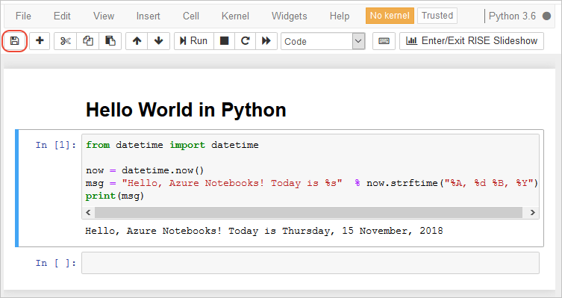
AZURE ML
Notebook:
Microsoft Azure ML Studio has Jupiter Notebook Servers which are directly integrated into the studio where you can write your own code.
We can use Jupiter notebooks directly in our workspace in Azure Machine Learning studio.
While we can launch Jupiter, we can also edit and run our notebooks without leaving the workspace.

Slide 11
AZURE ML
Automated machine learning: Automated machine learning, also referred to as AutoML, is the process of automating the time-consuming, iterative tasks of machine learning model development.
It allows Data scientists, ML Engineers to build ML models with high scale, efficiency, and productivity all while sustaining model quality.
Traditional machine learning model development is requiring significant domain knowledge and time to produce and compare dozens of models.
Therefore with the help of automated machine learning, we can save the time it takes to get production-ready ML models with great ease and efficiency.
When to use AutoML: Apply automated ML when you want Azure Machine Learning to train and tune a model for you using the target metric you specify.
We can use AutoML for : classification, regression, & forecasting

Slide 12
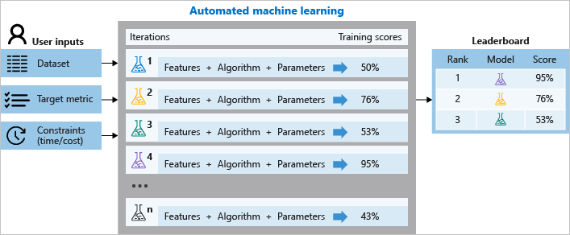
AZURE ML

Slide 13
AZURE ML
How automated ML works:
During training, Auto ML creates a number of pipelines in parallel that try different algorithms and parameters.
The service iterates through ML algorithms paired with feature selections, where each iteration produces a model with a training score.
The higher the score, the better the model is considered to "fit" your data. It will stop once it hits the exit criteria defined in the experiment.
For Auto ML Experiments, featurization is applied automatically, but can also be customized based on your data.
While doing experiment, data is automatically scaled or normalized to help algorithms perform well.
AutoML helps prevent over-fitting and imbalanced data in models.

Slide 14
AZURE ML
Workflow Of Azure Machine Learning Service:
Azure machine learning service workflow is a three-step process that includes:
Prepare Data
Experiment (Build, Train & Test the model)
Deployment
Prepare Data:
This is the first step in creating a machine learning model which includes collecting and processing the data from datastore and datasets.
Datastore: They are used to store connection information to Azure storage services which can be referred to by name and are attached to the workspace.
Some examples of supported Azure storage services that can be registered as datastores are:
Azure Data Lake
Azure Blob Container

Slide 15
AZURE ML
Experiment:
After the data is registered and stored in the dataset, the next step is to build, train, and test the model.
Model: It is a piece of code that takes input and produces the output for the given inputs. While developing a machine learning model, it requires selecting an algorithm, availing data, and tuning of hyperparameters. Training includes an iterative process which provides a trained model inheriting what it learned from the training process. The model is obtained by executing in Azure Machine Learning.
Deployment:
Once the model is trained and tested, it is stored in the model registry and then deployed in web service. The registered model is deployed as a service endpoint. It instantiates the image into a web service that is further hosted over the cloud or into an IoT module for using it in an integrated device deployment.

Slide 16
AZURE ML
Azure Blob Storage:
Blob storage act as the persistent store, where the data is stored for a long time. Every blob resides inside a container.
Blob storage is optimized for storing massive amounts of unstructured data.
One of the advantages of Blob Storage is that it offers zone-wise redundant processes.
Different copies of data are created in the same zone or across two separate zones in a zone redundant.
So, creating copies in two distinct zones helps in data recovery. If one of the zones faces any failure, then the Azure redundant process can still help retain data.
It even allows data read options from another location.

Slide 17
AZURE ML
Blob Storage Features:
Store Unstructured Data – All the unstructured data like images, videos, and audio can be stored in Blob.
Secured – Blob provides utmost security by following encryption technology, RBAC, and Active Directory.
Cloud Applications – Moreover, it is built keeping in mind the storage demand for developing mobile and web applications. Blob Storage also supports various languages such as Python,. NET etc.
Cost-effectiveness – Blob storage contains different tiers that help store a massive amount of data in a cost-efficient manner. Due to its lifecycle management, it becomes easy to manage those huge volume data.

Slide 18
AZURE ML
Blob Storage Pricing:
Hot Access – Data that is frequently used is stored in hot storage. It stores data utilized during migration processing. The storage cost is higher than Cool and Archive access but, the access cost is lower than the other two.
Cool Access – This tier helps store the data that is not accessed frequently. Its storage cost is lower, but the access cost is more than the Hot tier. It contains data that is going to stay for 30 days or more.
Archive Access – Data in this tier is stored for more than 180 days. The data stored in this tier are seldom accessed.
It has a lower storage cost but a higher accessing cost. Also, it takes time while retrieving the data because data is often considered to be in offline mode.

Slide 19
AZURE ML
Why Choose Azure Blob Storage:
Azure Blob Storage is created for storing unstructured data. One can opt for Blob Storage for streaming audio and video files.
Likewise, Blob storage is also used for storing data during backup, archiving, restoring, and recovering. Extensive volume data used for analysis by Azure services are also stored here.
Similarly, one can go for Blob Storage when uploading large files. Azure Blob storage breaks the large files into smaller chunks, and these chunks get uploaded individually. After uploading these chunks, they get merged into a single initial file.
Azure Blob storage also allows the storage of files and documents for providing distributed access.in addition to it, it can also be used for off-loading excess content from the servers to minimize the load.

Slide 20
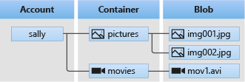
AZURE ML
Blob storage resources:
Blob storage offers three types of resources:
The storage account
A container in the storage account
A blob in a container
Containers:
A container organizes a set of blobs, similar to a directory in a file system. A storage account can include an unlimited number of containers, and a container can store an unlimited number of blobs

Slide 21
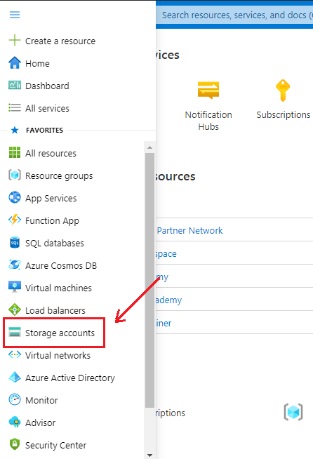
AZURE ML
Steps To Create Azure Blob Storage:
Step 1) Log in to AZURE PORTAL.
Step 2) The first and foremost step in creating Blob Storage is setting up the ‘Storage Account’. To create one, log in to the Azure portal, then click on ‘Storage Accounts‘.

Slide 22
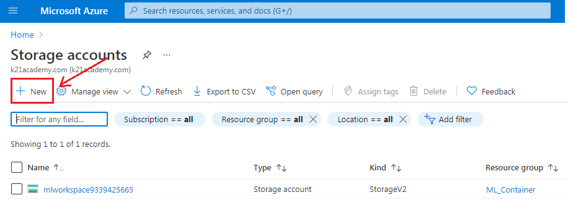
AZURE ML
Step 3: After clicking on Storge Account, the following screen will appear and then click on ‘+ New‘ to proceed further.

Slide 23
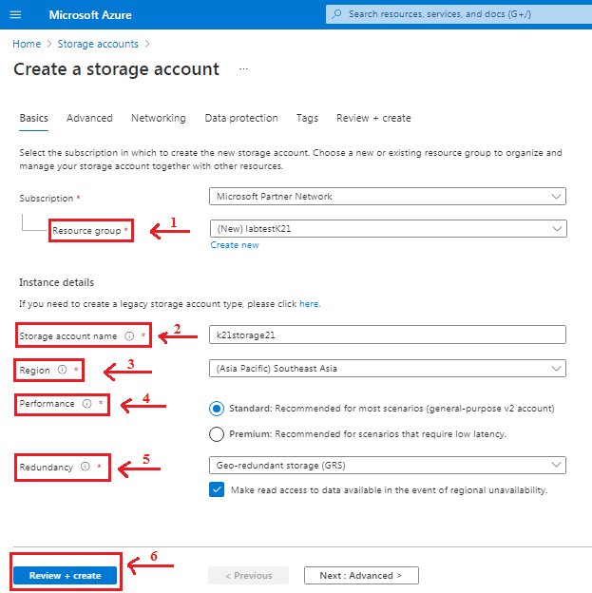
AZURE ML
Step 4: After clicking on New, it will take you to the next page and asks you to fill in the following details:
Subscription – It tells you about the billing, invoice details, and the current subscription.
Resource Group – If you are creating a new resource group, it will show (New) before the name.
Storage Account name – Specify the name of the account.
Performance – It offers two types of performance option. Standard (uses HDD Hard Disk Drives to store data) Premium ( uses SSD Solid-State Drives to store data)
Redundancy – Through Redundancy, Azure ensures that data is protected at times of failure.

Slide 24
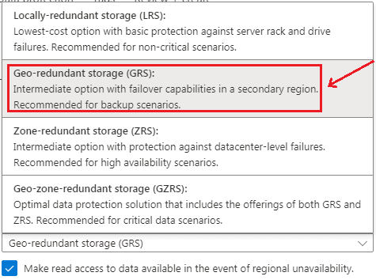
AZURE ML
Step 5:
Azure Storage Account provides four types of Redundancy Storage as shown in the sample.
We will choose one as required.

Slide 25
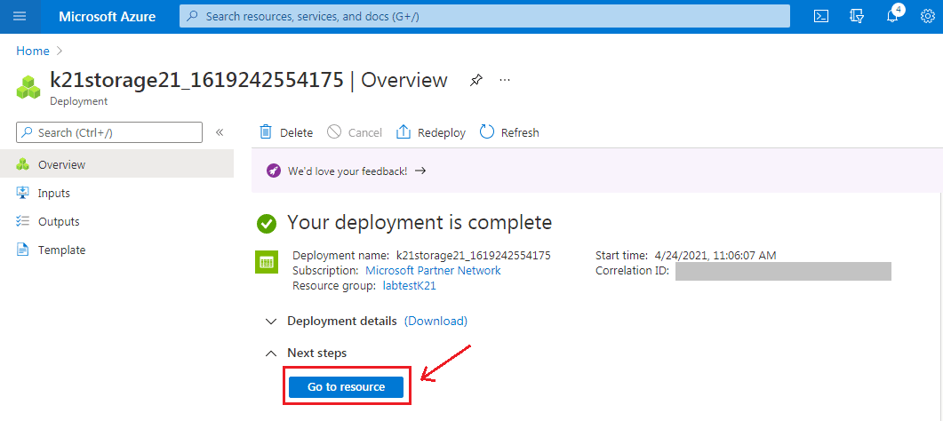
AZURE ML
Step 6: When you click on the ‘Create’ button, it takes you to the next screen that shows the deployment status. After deployment gets completed, click on ‘Go to resource‘.

Slide 26
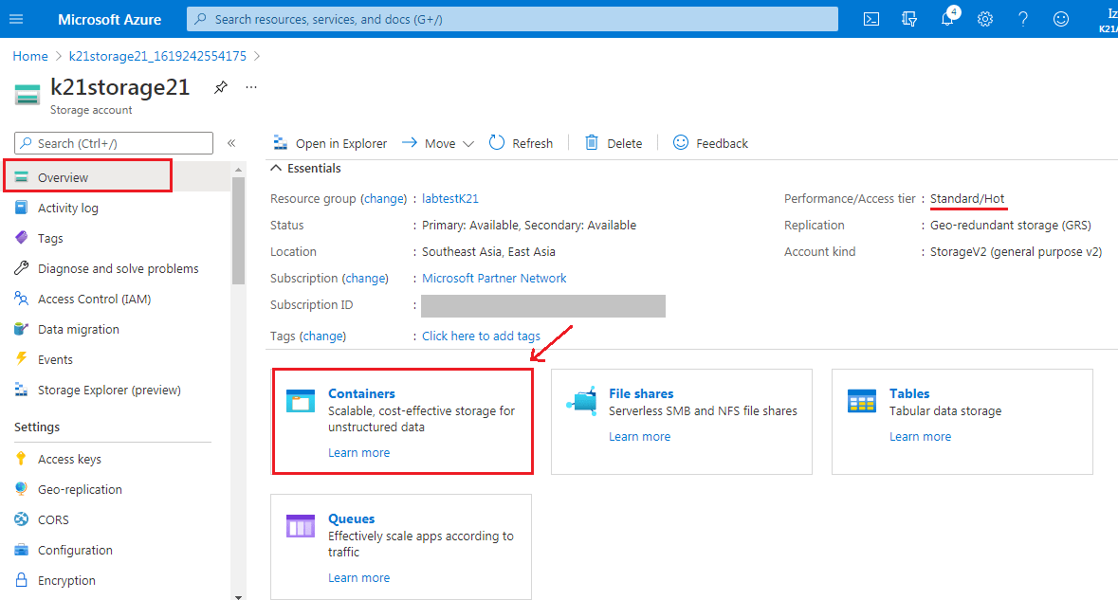
AZURE ML
Step 7: The following screen will appear, showing an ‘Overview’ of the created Storage Account. The next step is to click on ‘Containers‘ to select Blob Storage. We would choose the ‘Hot Access‘ etc. One can choose according to their requirements.

Slide 27
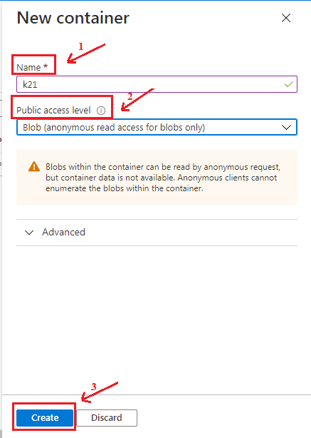
AZURE ML
Step 8: Now, we have to create a new Container for that click on ‘+ Container‘.

Slide 28
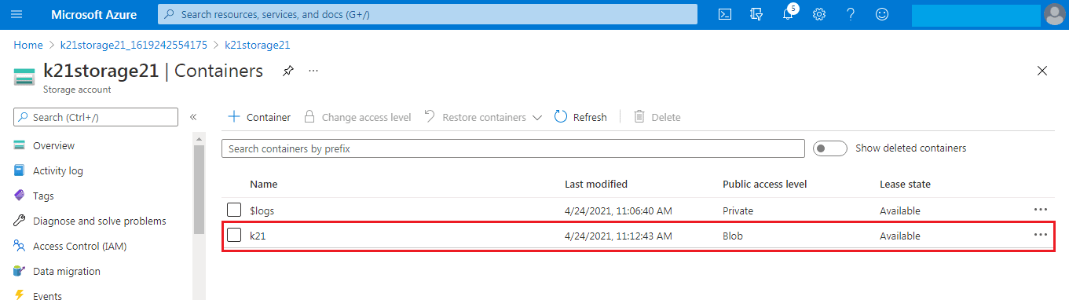
AZURE ML
Step 10: Hence we have successfully created the blob storage as we can see container k21 appears under the storage.

Slide 29
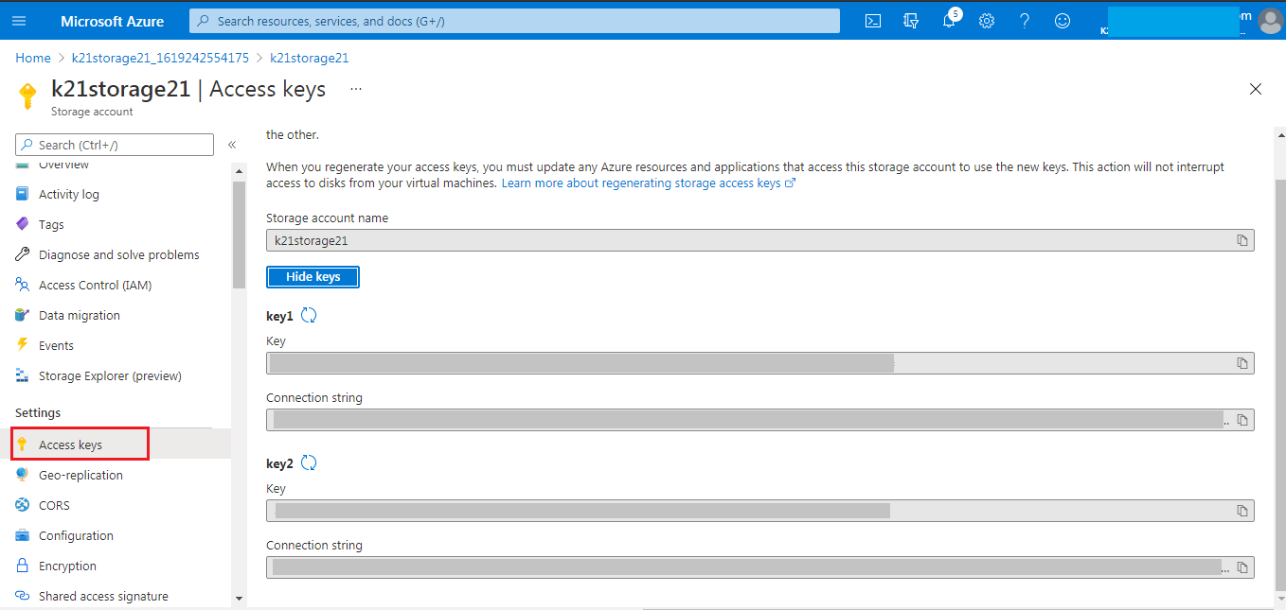
AZURE ML
Step 11: Next, select the Storage Account and click on ‘ Access keys‘ to find the connection string. Website’s code gets authenticated to interact with created Storage Account through this Connection Strings. All you need to do here is copy the connection string and paste it into the website’s code, and you are good to go.

Slide 30
AZURE ML
What Are Azure Datastores?
Datastores are attached to the workspace and can be referred by name. They are used to store connection information to Azure storage services.
There are various Cloud Data Sources which can be registered as datastores, some of them are:
Azure Storage- It is 500TB of object storage.
Azure Data Lake- It is basically the Hadoop File System (HDFS). There is no upper limit in the data lake (can store any amount of data).
Azure SQL Database- It is a Platform-as-a-service database where we can get structured data.
Azure Databricks File System- It is a local file system of the data bricks cluster, which is a spark cluster in the Azure cloud.
There are two built-in datastores in every workspace namely an Azure Storage Blob Container and Azure Storage File Container which are used as system storage by Azure Machine Learning.
Datastores can be accessed directly in code by using the Azure Machine Learning SDK and further use it to download or upload data or mount a datastore in an experiment to read or write data.

Slide 31
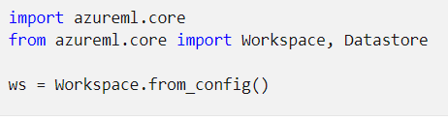
AZURE ML
Connecting data storage services with Azure ML datastores:
Keep in mind, if credentials are registered with datastores, all users with workspace Reader role are able to retrieve these credentials.
Import the Workspace and Datastore class.
load your subscription information from the file config.json using the function from_config().
This looks for the JSON file in the current directory by default.
but you can also specify a path parameter to point to the file using from_config(path="your/file/path").

Slide 32
AZURE ML
Create a datastore for an Azure Blob container: Create and register datastores:
When you register an Azure storage solution as a datastore, you automatically create and register that datastore to a specific workspace.
Datastore name should only consist of lowercase letters, digits and underscores.
Azure blob container:
To register an Azure blob container as a datastore, use register_azure_blob_container().
The following code creates and registers the blob_datastore_name datastore to the ws workspace.
This datastore accesses the my-container-name blob container on the my-account-name storage account, by using the provided account access key.

Slide 33
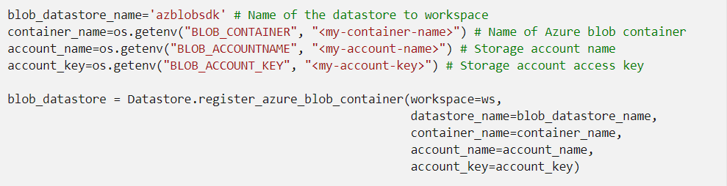
AZURE ML

Slide 34
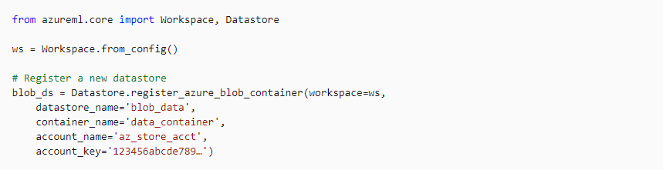
AZURE ML

Slide 35
AZURE ML
Azure Data Lake Storage Generation 2:
Azure Data Lake Storage Gen2 is built on top of Azure Blob storage and designed for enterprise big data analytics.
For an Azure Data Lake Storage Generation 2 (ADLS Gen 2) datastore.
use register_azure_data_lake_gen2() to register a credential datastore connected to an Azure Data Lake Gen 2 storage with service principal permissions
The following code creates and registers the adlsgen2_datastore_name datastore to the ws workspace.
This data store accesses the file system test in the account name storage account, by using the provided service principal credentials.

Slide 36
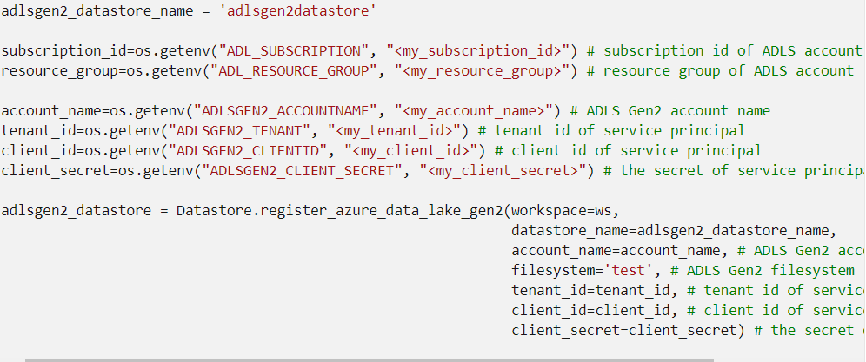
AZURE ML

Slide 37
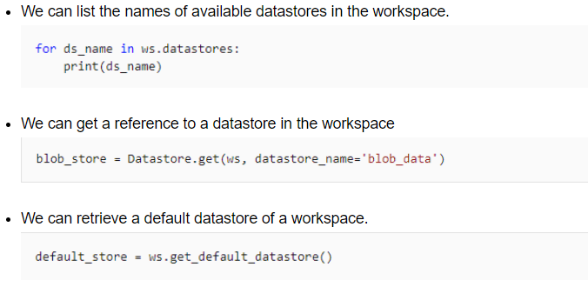
AZURE ML
Managing a datastore:
Datastores can be viewed and managed in Azure Machine Learning Studio or we can use the Azure Machine Learning SDK.

Slide 38
AZURE ML
What Are Azure Datasets?
A dataset is basically a schema or a versioned data object for experiments. Datasets can be dragged and dropped in the experiment or added with the URL
There are two types of datasets available in Azure:
File Dataset: It is generally used when there are multiple files like images in the datastore or public URLs. File Datasets are usually recommended for machine learning workflows as the source files can be any format that gives a wide range of machine learning scenarios along with deep learning.
Tabular Dataset: In a tabular dataset the data is represented in table format. This dataset format helps in materializing the dataset into Pandas or Spark.
Data Frame which allows the developer to work with familiar data preparation and training libraries without having to leave the notebook.

Slide 39
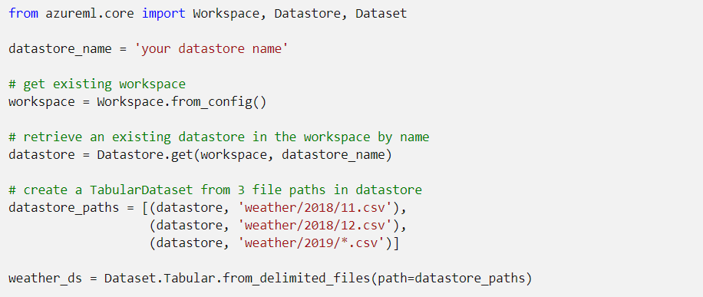
AZURE ML
Create datasets from datastores:
For the data to be accessible by Azure Machine Learning, datasets must be created from paths in Azure Machine Learning datastores. After you create and register your dataset, you can load it into your notebook for data wrangling and exploration prior to model training.

Slide 40

THANK YOU

